Slide 1
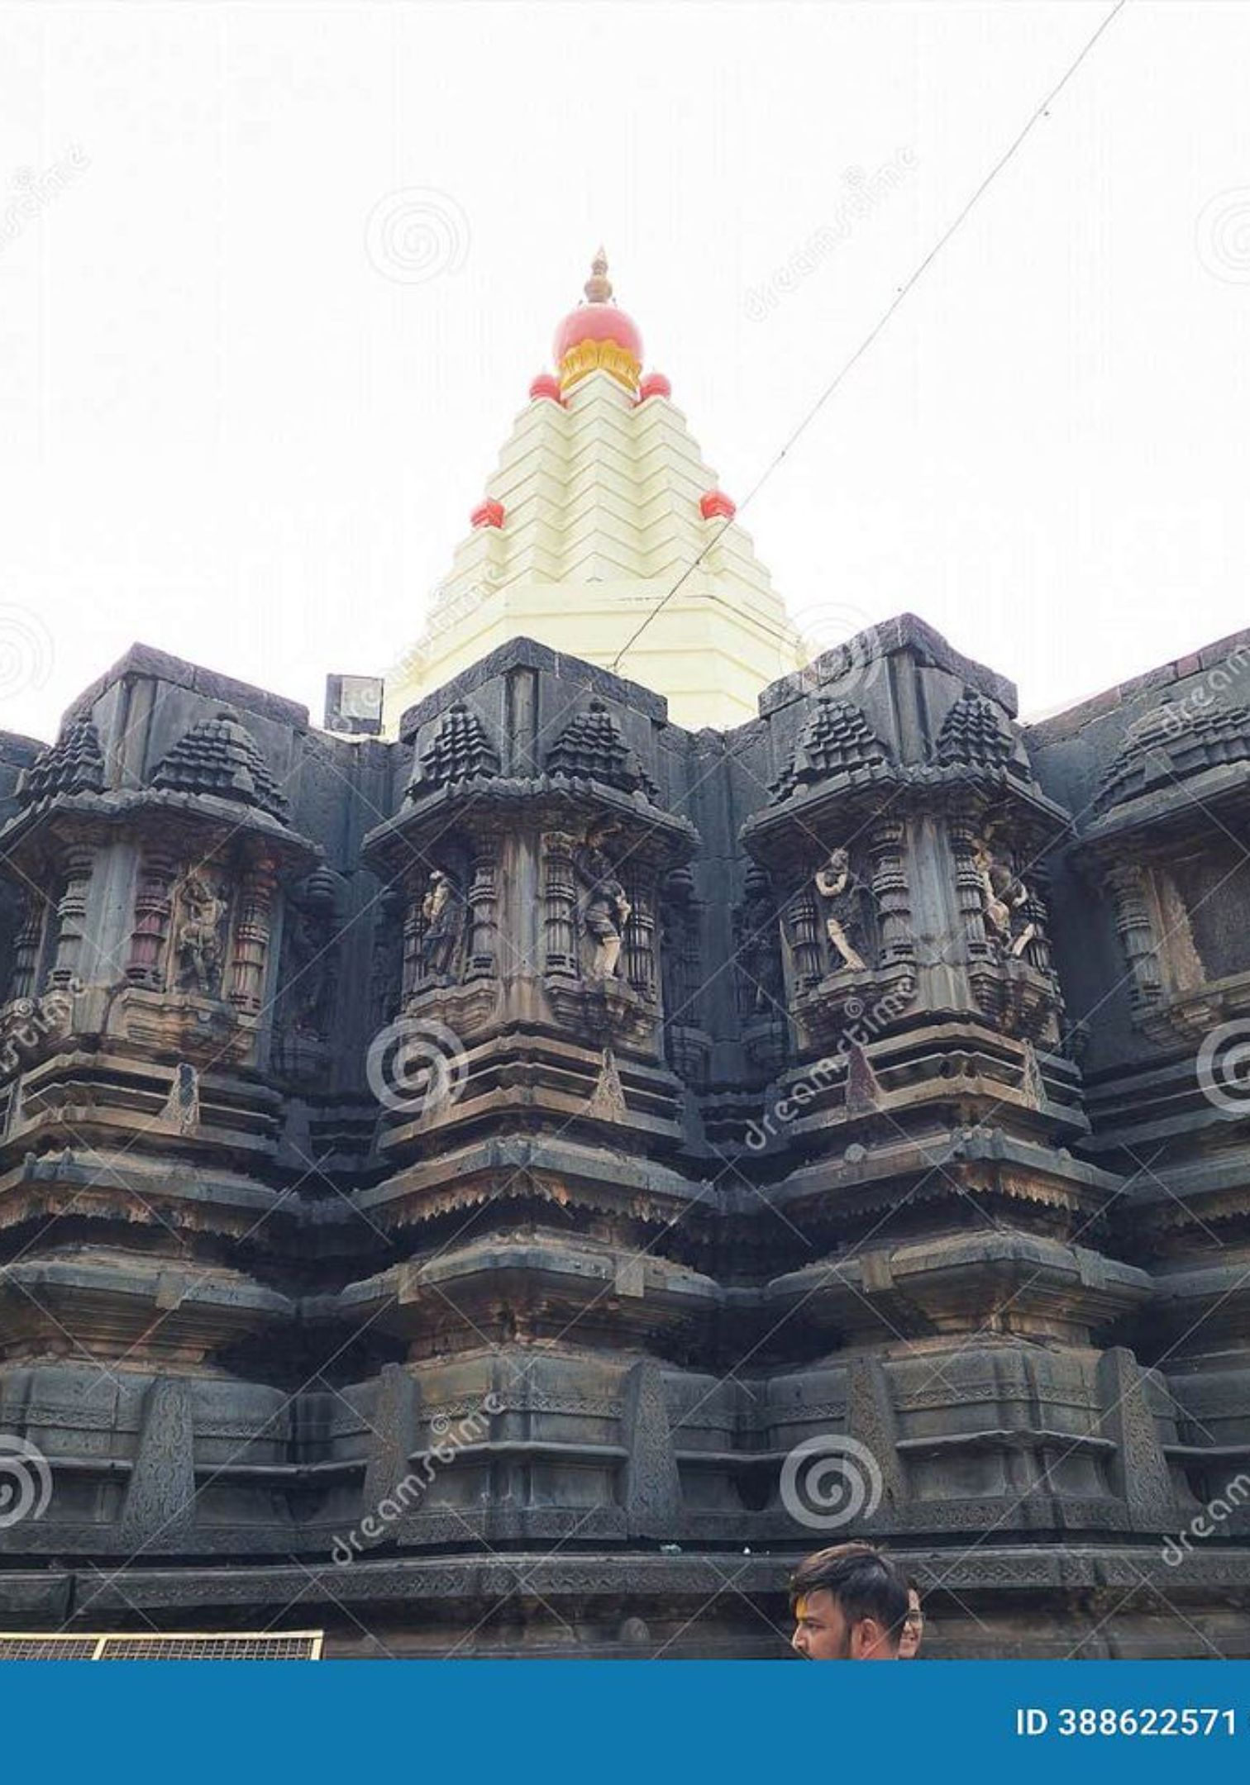
Community Engagement Program (CEP)
Visit to Mahalaxmi Temple, Kolhapur
Project: Smart Parking Management System
DKTE's Textile and Engineering Institute, Ichalkaranji
Department of CSE (AIML)
Group Member :
25UME044 : Ganesh Ujesh Raut
25UAM065 : Abhishek Ajit Shirguppe
25UAM069 : Sanket Subhash Patil
25UAM043 : Atharv Chandrashekhar Kagale

Slide 2

Introduction
Purpose of CEP Visit
To conduct a field study on real-world parking challenges at a high-traffic public location
Why Mahalaxmi Temple?
A major religious and cultural destination with significant visitor footfall, presenting practical parking management challenges
Connection to Project
Understanding existing parking problems provides essential requirements for designing our IoT-based Smart Parking Management System
Objective
Observe parking difficulties, collect user feedback, and identify technological solutions for efficient parking management

Slide 3
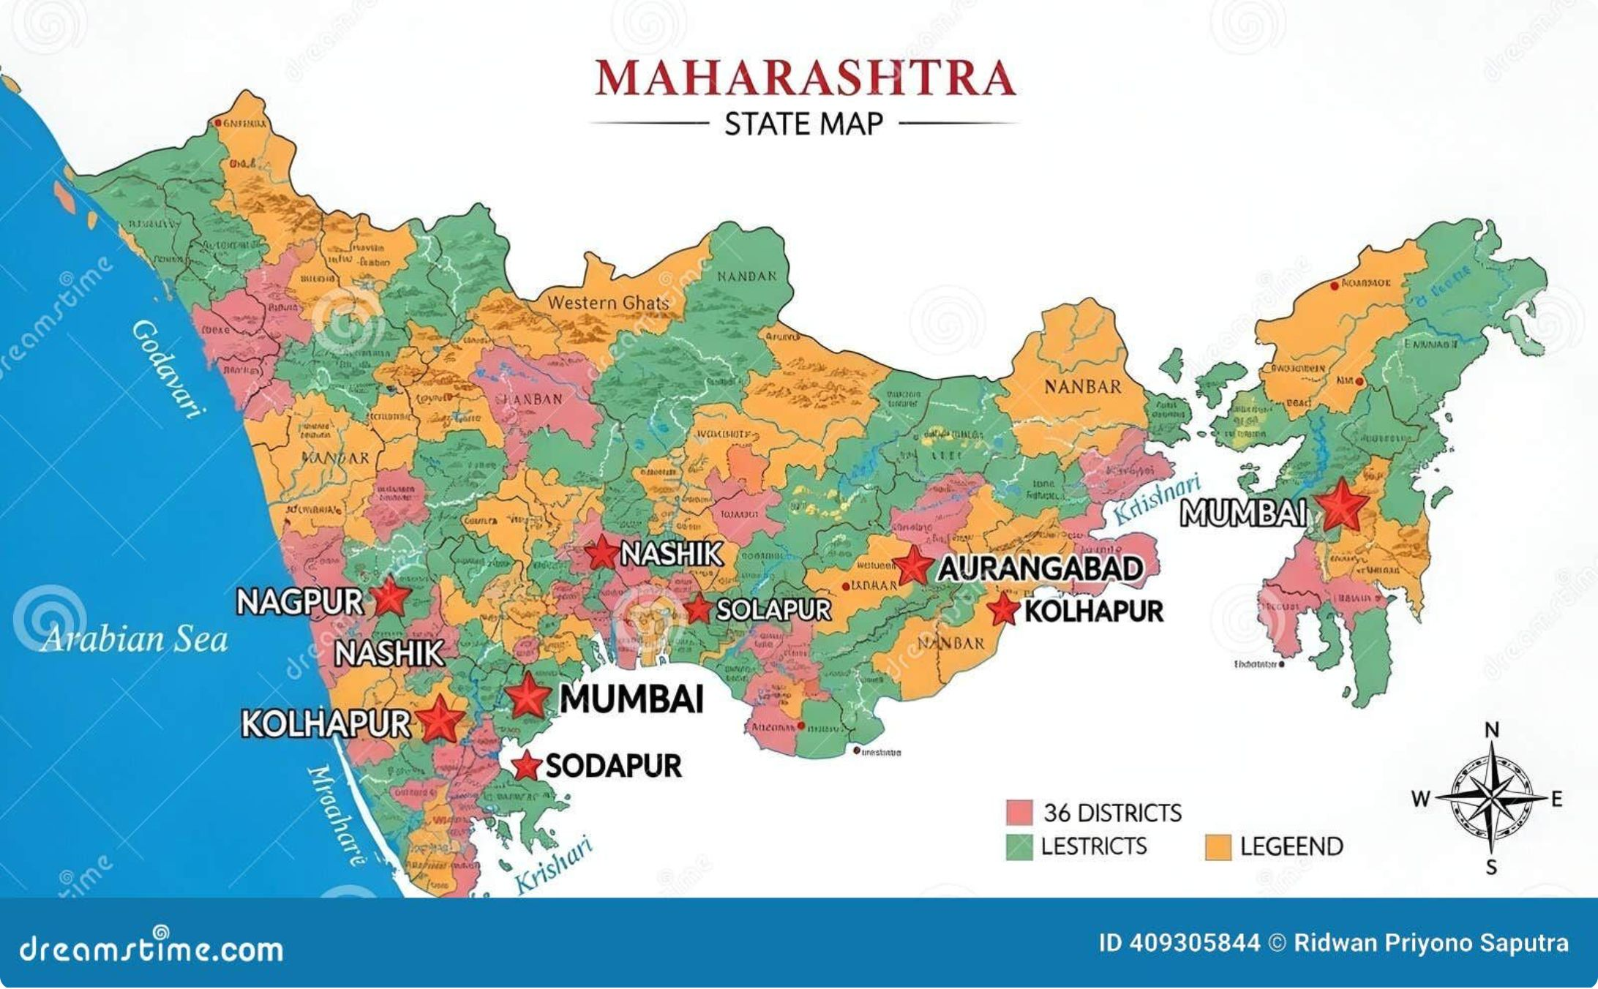
Visit Details
Field | Details
Location | Mahalaxmi Temple, Kolhapur
District / State | Kolhapur, Maharashtra – 416012
Reference Code | DKTE/TEI/CCSEAIML
Activity | Field visit and information gathering
Project Focus | Smart Parking Management System using IoT
Project Co-ordinator | Mrs. R. S. Kamble
H.O.D. CSE (AIML) | Prof. Dr. S. K. Shirgave

Slide 4
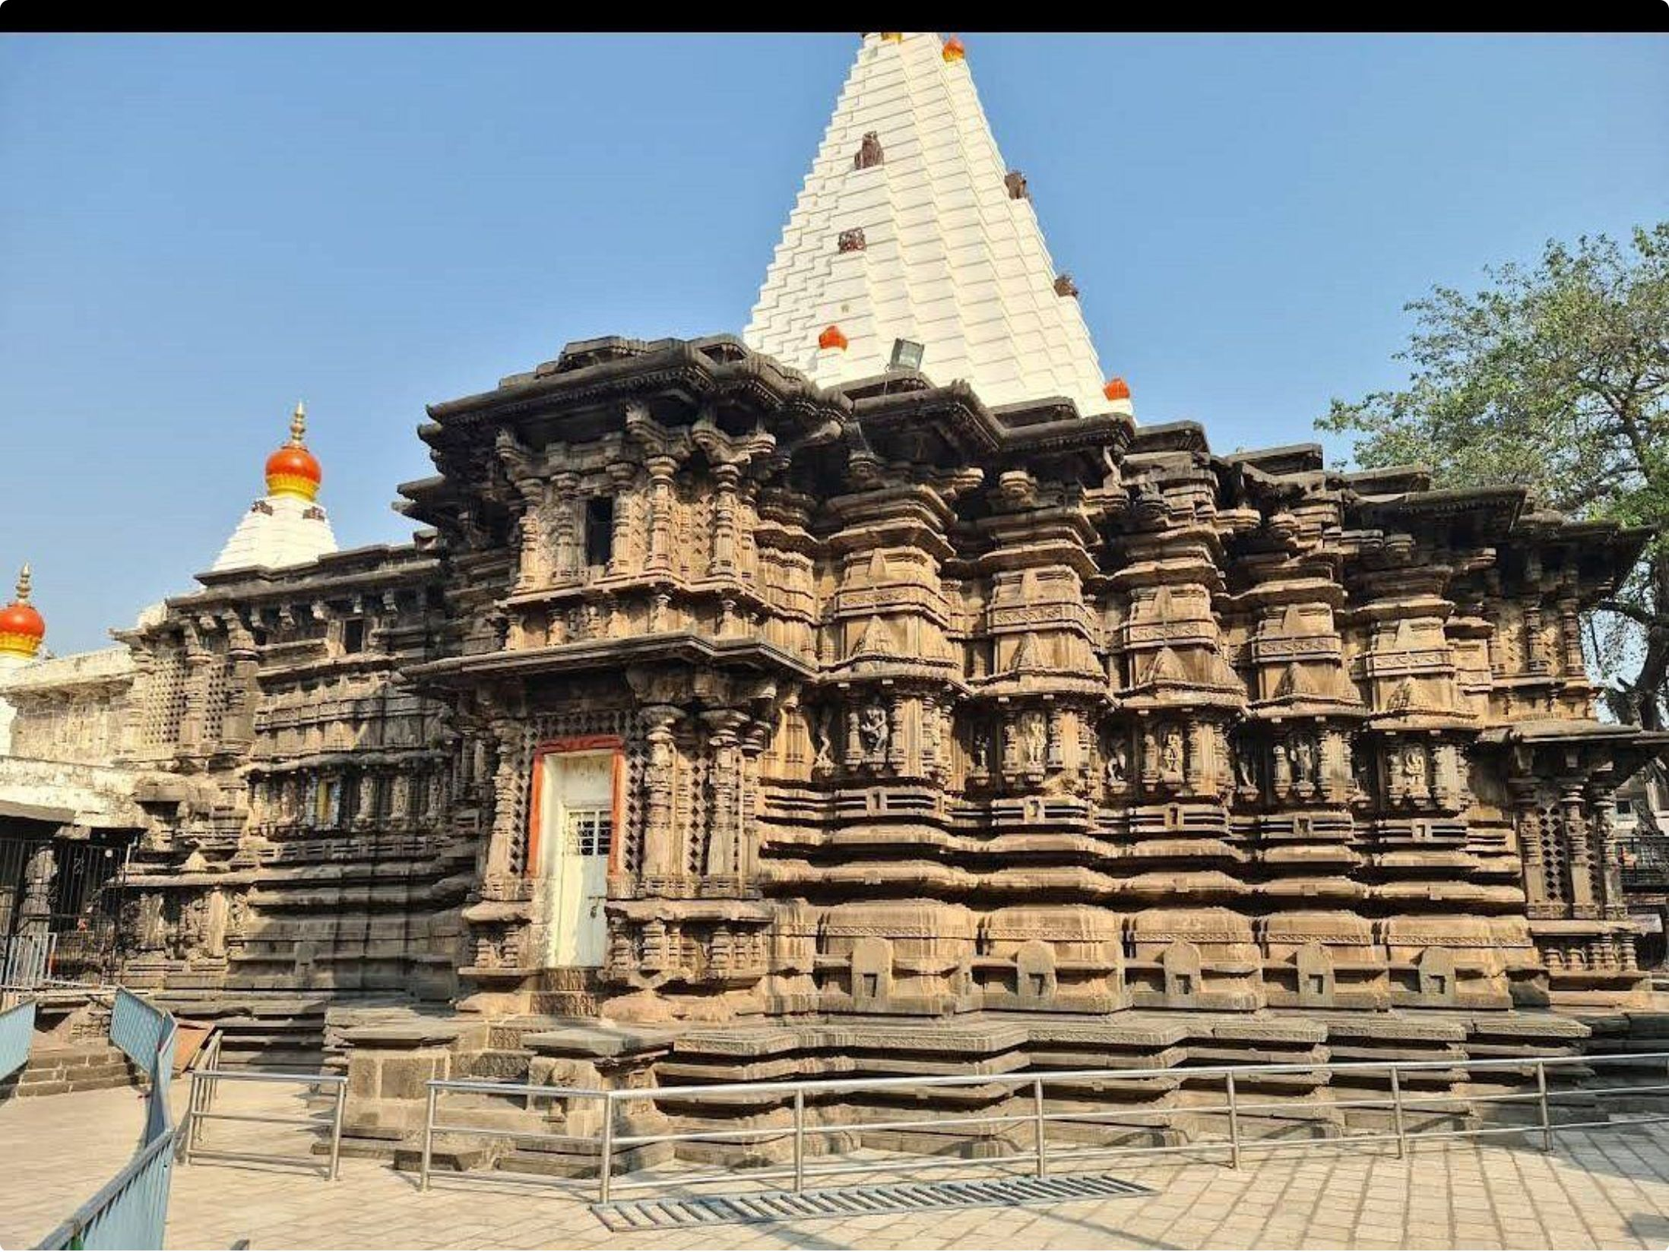
About Mahalaxmi Temple, Kolhapur
Significant Religious Landmark
One of the most important religious and cultural destinations in Maharashtra, attracting devotees year-round
High Visitor Footfall
Particularly crowded during festivals and weekends; serves as a major pilgrimage destination with continuous visitor flow
Parking Demand Challenge
The high volume of visitors creates substantial parking demand; existing infrastructure requires optimization for better visitor experience

Slide 5
Objectives of the Visit
1
Observe Infrastructure
Observe the existing parking arrangement and infrastructure at the site
2
Understand Difficulties
Understand difficulties faced by visitors while parking during peak and off-peak hours
3
Identify Bottlenecks
Identify possible parking management problems and traffic flow bottlenecks
4
Collect Requirements
Collect information useful for our IoT-based smart parking project design
5
Technology Assessment
Understand how technology can improve parking management efficiency at scale
6
Gather Feedback
Interact with visitors and staff to gather relevant first-hand feedback

Slide 6
Observations During the Visit
🅿 Space Availability
🚧 Organisation
🪧 Guidance System
🚦 Entry/Exit
Parking areas lack clear demarcation, systematic layout, and proper signage
Unorganised entry and exit points; potential for traffic bottlenecks at peak times
Limited visibility of available parking spaces; visitors struggle to locate vacant spots
Minimal or no signage indicating vacant parking spaces or directional guidance
🚗 Congestion
📡 Real-time Gap
🔒 Safety
Significant congestion during peak hours; inefficient vehicle movement observed
Absence of real-time parking availability information for incoming visitors
Need for better security and monitoring of parked vehicles throughout the facility

Slide 7
Questions Asked / Information Collected
01
02
03
Major Parking Problems
Space Availability
Current Management
What are the major parking problems faced by visitors?
Is it difficult to find an available parking space during busy periods?
How is parking currently managed? Is there any system to indicate vacant spaces?
04
05
Entry/Exit Flow
Security & Future Needs
How are entry and exit of vehicles managed? Are parking spaces clearly marked and numbered?
What safety measures are available? Would real-time information be useful? What improvements would help?

Slide 8
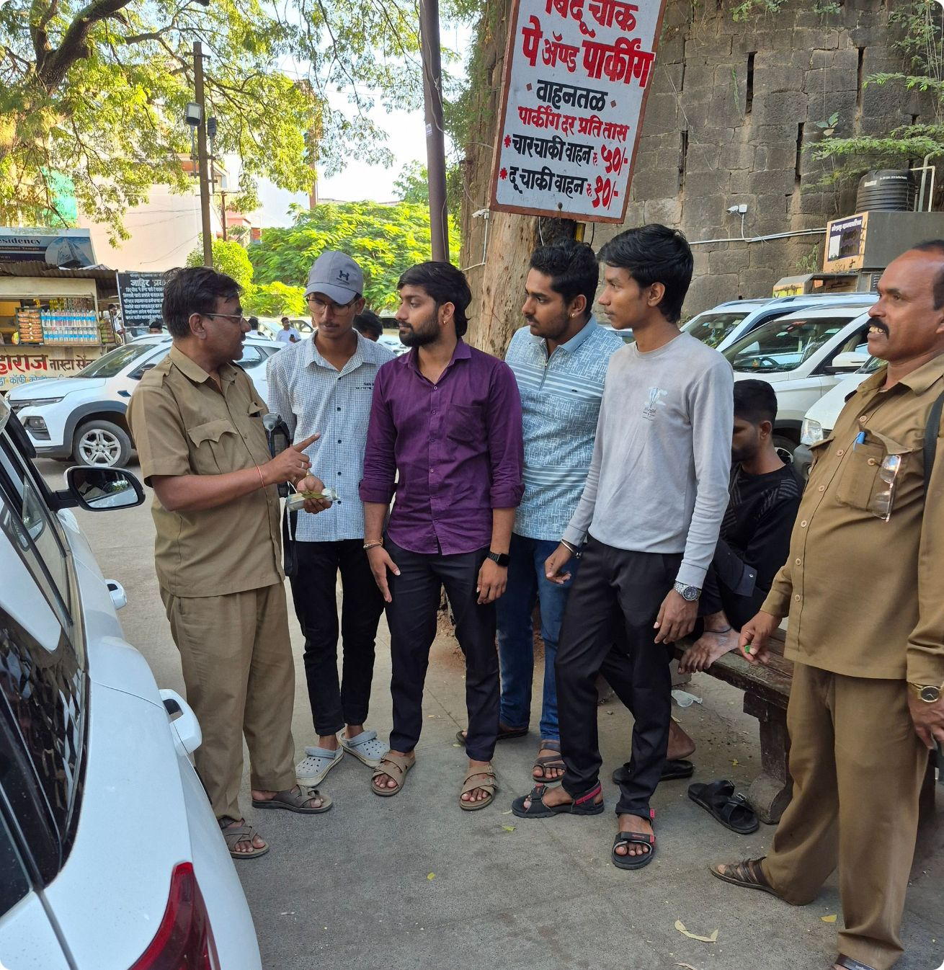
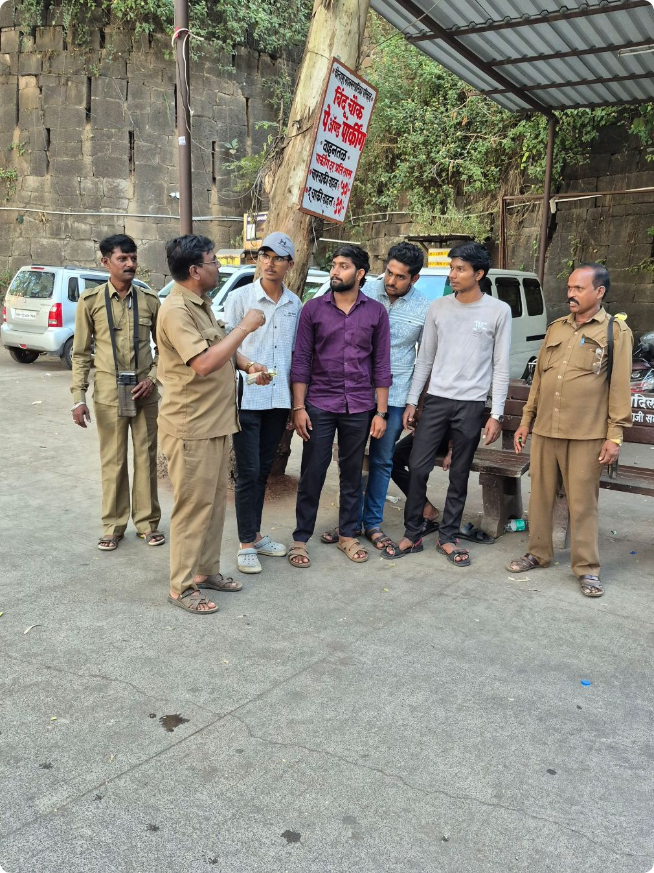
Group Visit Photos
Interaction with the concerned person regarding parking management.

Slide 9
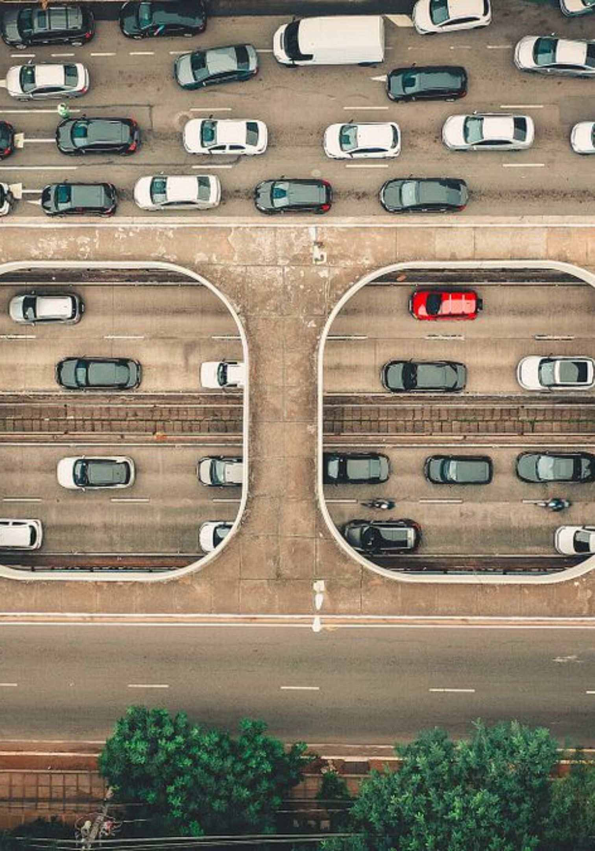
Connection with Our Project
Parking-Space Detection
IoT sensors detect occupancy of individual parking spaces in real-time, eliminating manual counting
Real-time Vacancy Information
Available parking slots displayed to incoming visitors through mobile app or digital signage boards
Better Vehicle Flow
Organised parking guidance reduces congestion and improves traffic movement within the premises
IoT Cloud Connectivity
Cloud-based system enables centralized monitoring, data-driven insights, and optimised space utilisation

Slide 10
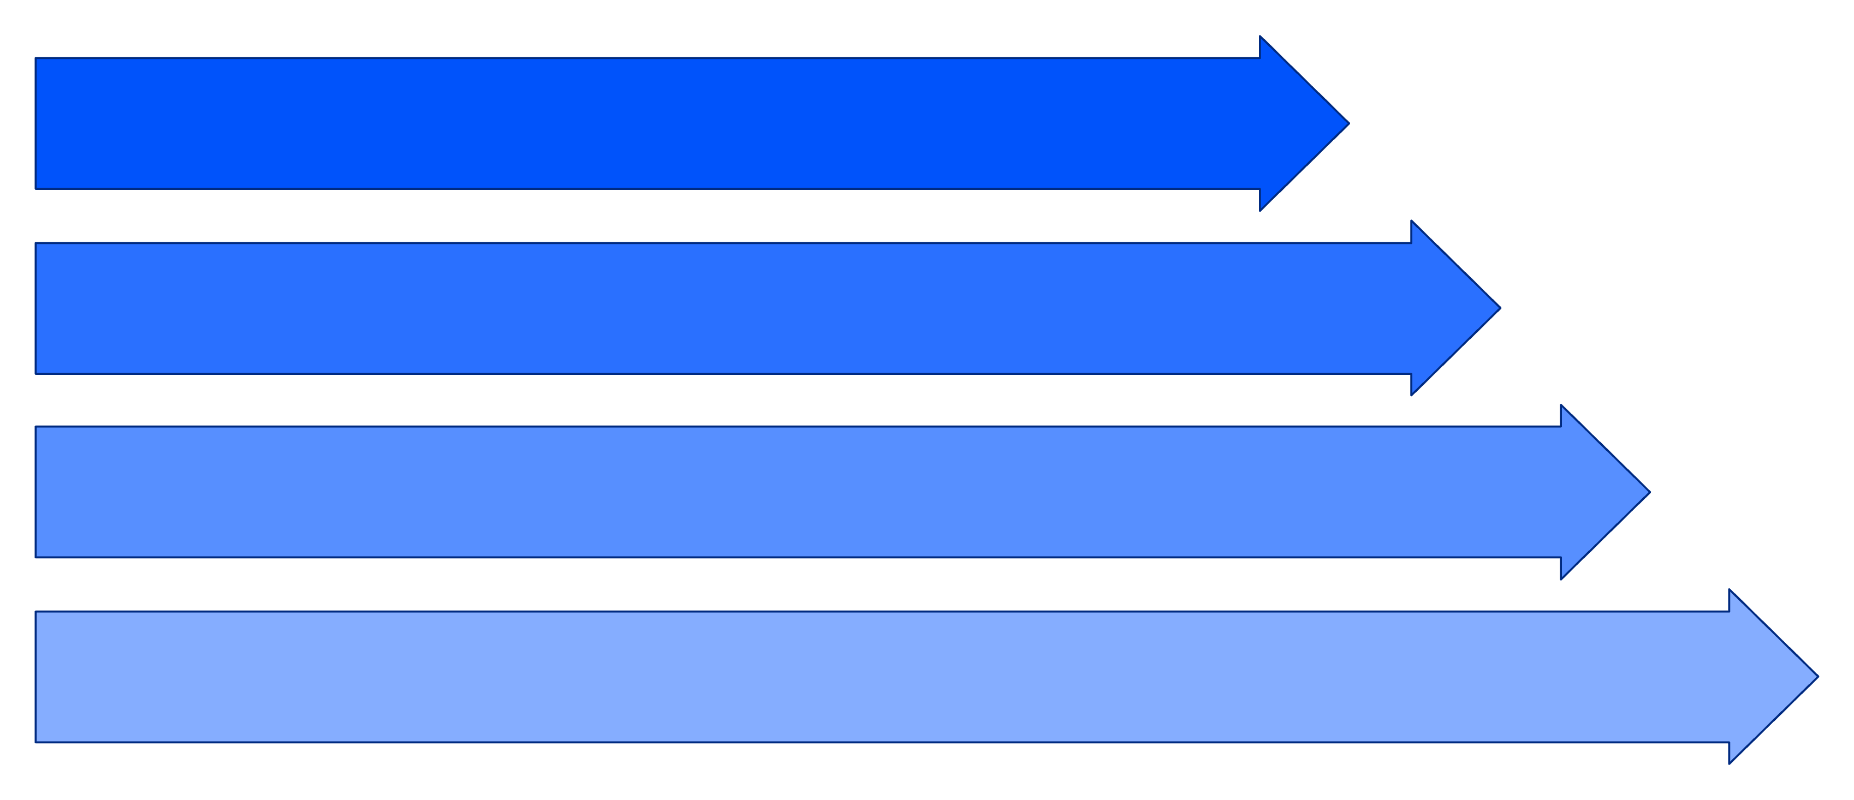
Proposed Smart Parking System Architecture
Detect Vehicle
Controller Unit
Cloud Database
User Interface
IoT Sensors
Controller Unit
Cloud Database
User Interface
Ultrasonic or infrared sensors monitor each individual parking space for occupancy status
Processes sensor data and communicates updates to the cloud system in real-time
Stores real-time parking data and historical analytics for administrative insights
Mobile app or digital display boards show available parking to visitors in real-time
Note: This is our proposed project concept and is not an existing system at Mahalaxmi Temple, Kolhapur.

